Slide 1
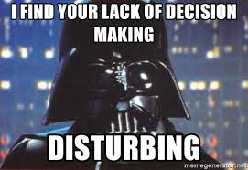
Algorithms and Decision-Making in Government: Theory
Discussion on Readings
Yinan Kang
ZhiMin Xiao
ISMT S-143

Slide 2
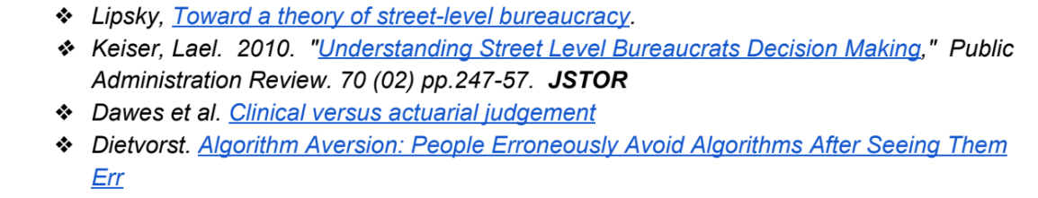
Decision-Making in Government - Theory “Rational” Systems vs. Human Nature
Written methodologies for decision-making in Government are based off rationality, laws, and logic
However, despite the intent for objectivity and consistency, reality is very different from theory
4 Readings:

Slide 3
“Toward a Theory of Street-Level Bureaucracy” – Michael Lipsky
Summary:
Studies the perspective of “Street-level Bureaucrats” (SLBs)
Def: People employed by government who:
Are constantly called upon to interact with citizens
Have significant independence (and discretion) in decision-making
Can have extensive impact on lives of clients
Ex: Teachers, police, judges, social security officials, etc.

Slide 4

“Toward a Theory of Street-Level Bureaucracy” – Michael Lipsky
SLBs are a relatively small % of the population, yet often serve and affect large areas of people
Given this environment:
Who are their clients?
What resources to they use?
How do they make decisions?

Slide 5
“Toward a Theory of Street-Level Bureaucracy” – Michael Lipsky
According to author
Clients: The most difficult decisions often involve minority and/low low-income populations
+
Resources: Very little, both financially and man-hours
=
Decisions: Susceptible to human influences, i.e. personal values, simplification, judgements

Slide 6

“Toward a Theory of Street-Level Bureaucracy” – Michael Lipsky
(1) Example of SLB Decision:
Scenario: A barfight breaks out between 2 people. Each has a friend who begin arguing, but do not fight.
2 police officers show up to the scene.
Theory: Police officers corroborate witness accounts, briefly consider evidence, determine if it was a mutual fight or a self-defense scenario, and arrest combatant(s). [Just an example, I’m not a lawyer ☺]
SLB Reality: Most people at the bar are unruly and incoherent. The 2 officers have no back-up available, and are needed elsewhere. With no clarity, they arrest all 4.

Slide 7

“Toward a Theory of Street-Level Bureaucracy” – Michael Lipsky
(2) Example of SLB Decision:
Scenario: A teacher in a poor, high-crime school district has a strict curriculum to cover. Each day must see significant progress, or else the curriculum falls behind.
However, the students are extremely unruly, and fights are common.
Theory: The teacher instills and maintains a peaceful classroom. The students are made to see the value of education, and learn the curriculum.
SLB Reality: To prevent literal physical harm, the teacher spends most of the day peace-keeping and settling disputes. Very little educational progress is made.

Slide 8
“Toward a Theory of Street-Level Bureaucracy” – Michael Lipsky
Author’s main points:
Defining what “Street-Level Bureaucrats” are
Identifying their interactions with clients, and the challenges that exist
Promote further research into the SLB-client interaction

Slide 9
“Understanding Street-Level Bureaucrats’ Decision Making: Social Security” – Lael R. Keiser
Summary:
“One-on-One” interactions between SLBs and clients are decreasing, as automated intake procedures are instituted
This reading focuses on the case example of the Social Security Disability program
Author chose this because the program is expansive, and lots of SLB discretion exists during the approval process
Explains “bounded-rationality theory”

Slide 10
“Understanding Street-Level Bureaucrats’ Decision Making: Social Security Disability” – Lael R. Keiser
Social Security Disability Insurance (DI) and Supplemental Security Income (SSI):
People can apply for these benefits, and then are deemed if they fit the eligibility requirements
Often, an applicant’s eligibility is not clear -> SLB makes determination
Reasons:
Injuries or pains affect people differently
Doctor opinions can differ
Concept of “disability” resists precise definition or measurement
Mental illness’ affects on work ability is hard to quantify

Slide 11

“Understanding Street-Level Bureaucrats’ Decision Making: Social Security Disability” – Lael R. Keiser
Theory of “Bounded Rationality”
“Information in public policy is inherently ambiguous … individuals may respond differently to the same information when making decisions … Individuals process information through a filter created by their personal attitudes and experiences”

Slide 12
“Understanding Street-Level Bureaucrats’ Decision Making: Social Security Disability” – Lael R. Keiser
Author points to 3 particular kinds of attitudes that may explain eligibility decision-making of SLBs:
Political ideology
Adherence to bureaucratic goal or mission, including what’s happening elsewhere in the bureaucracy
(Subjective) Client Assessment
Author then creates a study based on these ideas

Slide 13
“Understanding Street-Level Bureaucrats’ Decision Making: Social Security Disability” – Lael R. Keiser
Author’s Views
Political Ideology:
SLBs often have discretion, while serving multiple/vague goals
Personal ideology on welfare may sway the occasional decision
Bureaucratic Goal/Mission:
Organizations tend to unite multiple goals under umbrellas
Author points that the goals of Social Security SLBs are contradictory: “to grant access to a needy population” & “protect the solvency of the Social Security Trust Fund”
How SLBs make decisions could be swayed by which sub-goal they personally prioritize

Slide 14
“Understanding Street-Level Bureaucrats’ Decision Making: Social Security Disability” – Lael R. Keiser
Author’s Views
(Subjective) Client Assessments:
SLBs have traditionally done face-to-face interactions with clients. This grants clients an opportunity to introduce emotional and physical influences
Even in today’s automated environment, seepage of subjective client assessments can still slip through (client biography, appearance, written statements, etc.)

Slide 15
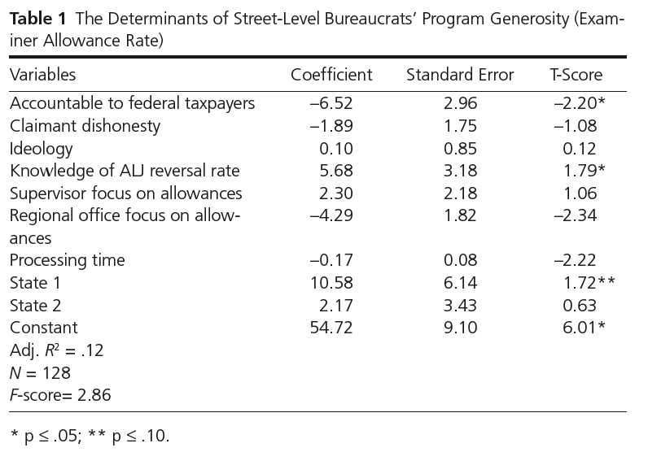
“Understanding Street-Level Bureaucrats’ Decision Making: Social Security Disability” – Lael R. Keiser
Author’s Views
The Author performed a study, via mailed surveys to Social Security examiners (target SLBs) in multiple states
Results (in short):
Variance can be explained by:
Perception of activities in other bureaucracies
Attitudes about the goals of the organization
No evidence suggesting political ideology or client assessment makes a difference

Slide 16
“Understanding Street-Level Bureaucrats’ Decision Making: Social Security Disability” – Lael R. Keiser
Author’s main points:
Introducing a real-life example of studying SLB behavior
Introduce ideas on what impacts SLB behavior
Performed a study on it, and included results

